Slide 1


Pro-
DEMOCRACY
What can I DO?
guide

Slide 2
What are people doing in this moment?
Protecting voting rights and elections
Resisting authoritarianism and Project 2025 implementation
Electing great candidates in the 2026 midterms
Enlarging and strengthening the mass movement of people

Slide 3





What can I do?
Use Your Voice
Call or write your representatives, join protests and rallies, vote,
post on social media, hold signs on bridges and corners,
talk with friends and family
Volunteer
Knock doors for candidates, work at the polls, phonebank for candidates,
staff voter information hotlines
Organize
Reach out to and ask friends, neighbors, classmates,
and community members to join you in getting involved
Donate
Anything helps!

Slide 4



Does it work?
CALLS TO CONGRESS
“I get asked all the time, ‘Does my voice even matter? Does calling my members of Congress even do anything?’ YES!
Your
calls are the reason why the public lands sale was taken out of the big, ugly bill.”
-Rep Melanie Stansbury, D-NM
ATTENDING PROTESTS
Nonviolent protests stiffen Democrats’ spines, create solidarity and networks, and shape what the country talks about.

Slide 5

What can I do with 5 minutes?
  Sign up for weekly emails from Indivisible or other groups for their analysis of issues and opportunities.
  Check out 5calls.org, choose an issue, and use their script to make a few calls to your Members of Congress. All you do is say a sentence or two on your position, then your opinion gets tallied and reported.
  Share stories of resistance and courage on your social media platforms, as this builds the narrative of hope and change.
  Donate to a pro-democracy organization or campaign. Consider Purple2Blue - Amherst alums supporting key state legislature races.

Slide 6
What can I do with an hour or two?
  Look up capitulating and resisting companies and consider how you spend your money.
  Attend a town hall meeting.
  Join a phonebank to support a candidate or issue. Check out Mobilize.us to find one.
  Share this guide with people in your network, asking them to get involved somehow – join you in a phonebank or at a protest, volunteer at a polling site or a hotline, donate
  Urge family and friends to 1) check their voter registration status (voter roll purges are happening across the country) and 2) vote Dem all the way down the ballot. 74% of Dems only vote the top of the ticket, which means we lose races we shouldn’t. Bluevoterguide.org tracks all candidates and issues by zipcode.

Slide 7


What can I do with half a day?
  Attend a rally/protest/vigil.
  Assist voter registration efforts, for example by contacting your local League of Women Voters to learn of their work.
  Sign up to pass out sample ballots or be a poll greeter during early voting and election day, by contacting your local Democratic party.
  Knock doors for a candidate or issue. Check out Mobilize.us for canvassing opportunities near you. Bring a friend and make it an outing!

Slide 8




What can I do with a full day?
  Sign up with Powerthepolls.org to serve as a poll worker.
  Travel to a high-priority neighborhood in a city or state away from home to canvass for the day.
  Check out Swing Left’s new Ground Truth trust-building initiative, created after analyzing what went wrong in 2024. You talk to ALL voters, listening rather than lecturing. Early reports are that it’s a success both for voters as well as canvassers.

Slide 9







Resources
If you track one activist org, Indivisible could be it! Strategic action alerts and commentary. Find a group near you.
The Movement Voter Fund is one-stop-shop for identifying and supporting local organizations doing
on-the-ground work to win in 2026 and beyond.
Search Mobilize.us for activist opportunities by category, location, date, and more.
The States Project is the only national organization hyper-focused on both winning state legislative power and helping state lawmakers govern effectively.
Phone calls from constituents have proven impact and are quick and easy. 5calls.org gives scripts for all hot issues.
Ground Truth upends traditional voter contact for a trust-building approach in key races: talk to ALL voters, not just registered Dems, and listen rather than lecture.
Protect Our Election offers ways all of us can support our free and fair election process and push back against baseless voter fraud claims.

Slide 10
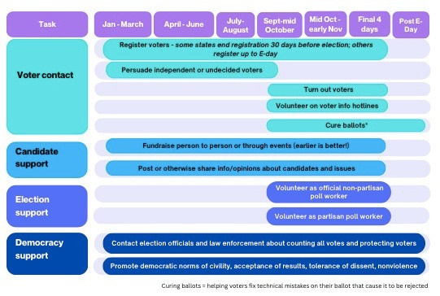
How can we get involved in midterms?

Slide 11





Think through your network
Family and friends
Sports clubs
Alumni or alumni clubs
Professional, cultural, or charitable associations
Churches, synagogues, mosques, etc.

Slide 12
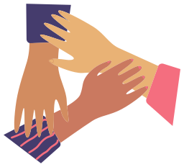
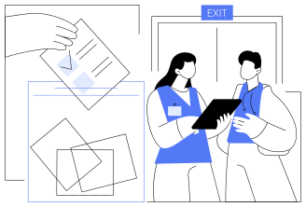
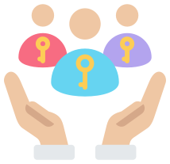






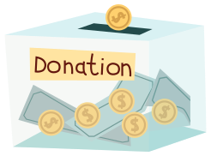
Write, call, or knock doors
Volunteer at the polls
Mobilize others to use their networks
Ask them to ...
Vote Dem up and down ballot
Join a Winning Wednesday
Update their registration status
Donate
Post on social media
Attend a protest

